Slide 1

EVALUATION OF BREAST CANCER RNA-SEQ GENE EXPRESSION PROFILE:
PHENOTYPING, BIOMARKER DISCOVERY AND CLASSIFICATION
Computational Medicine 02-518/02-718
Presented by
Brittany Gomez , Michael Aksu, Priyamvada Kumar

Slide 2
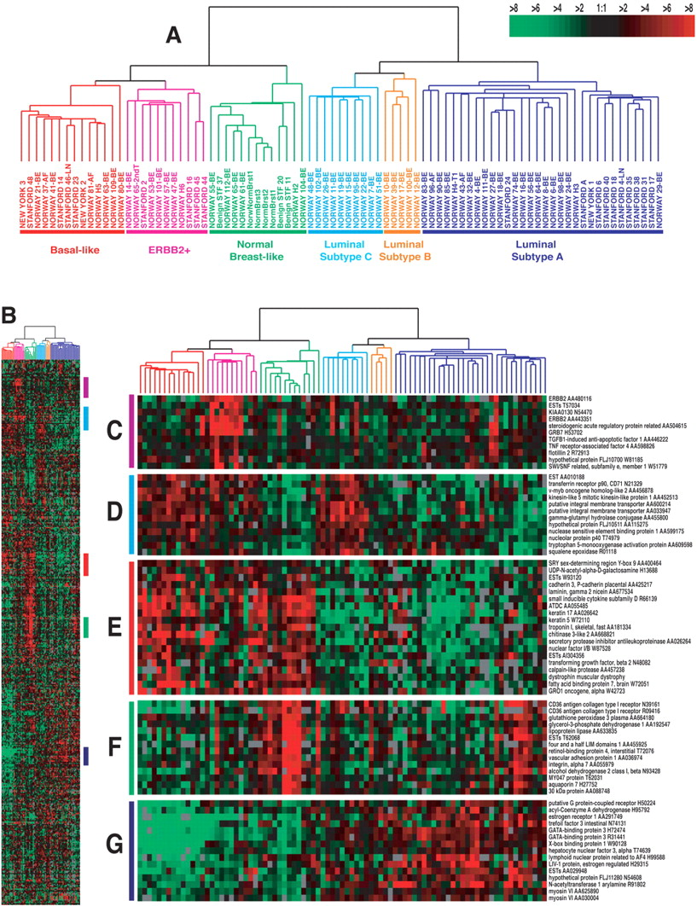
Background
PHENOTYPING
GENE SET ENRICHMENT ANALYSIS
CLASSIFICATION
Fig.1 Gene expression data from Breast cancer samples
Sørlie, et al PNAS(2001) https://www.pnas.org/content/98/19/10869

Slide 3
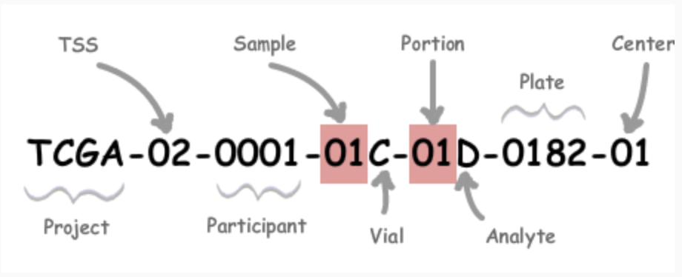
Methodology - Dataset I and Evaluation
547 Samples X 17814 Genes:
525 tumor samples + 22 Normal samples
Fig. 2 Reading TCGA Barcode https://docs.gdc.cancer.gov/Encyclopedia/pages/TCGA_Barcode/
Dataset: https://gdc.cancer.gov/about-data/publications/brca_2012

Slide 4
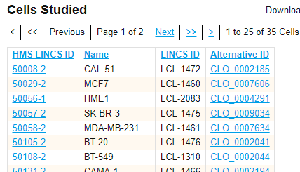
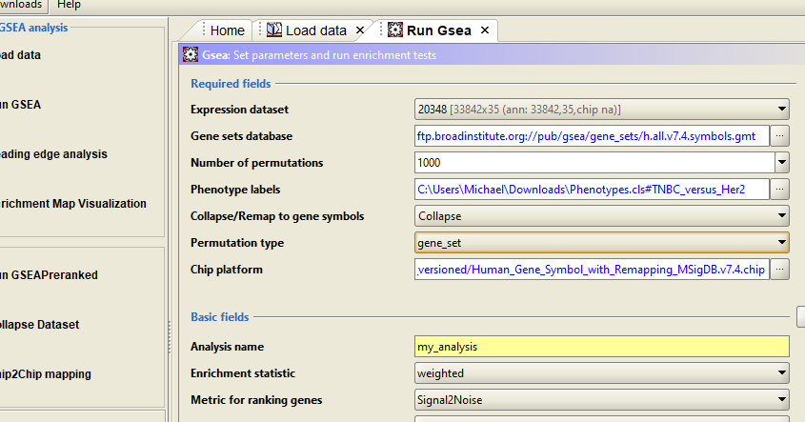
Methodology - Dataset II and Evaluation
GSEA
Fig.3 Dataset
https://lincs.hms.harvard.edu/db/datasets/20348/main
Fig.4 GSEA_4.1.0 Desktop App
https://www.ncbi.nlm.nih.gov/pmc/articles/PMC5665029/
https://www.ncbi.nlm.nih.gov/pmc/articles/PMC2702084/
33 Samples X 24047 Genes:
23 Triple-Negative, 6 HR+, 4 Her2+

Slide 5
Classification - Tumor vs Normal Samples
Feature Selection
Extract Features &
Encode Response Variable
ANOVA F-test
Oversampling and Undersampling
Train - Test Split
Data Preprocessing
Data Imputation
Models fitted with GridSearchCV
Stratified Cross Validation
(7 splits ,10 repeats)
Normalization
Check model performance on test set
with best hyperparameters
Metrics Output

Slide 6
Phenotyping - Tumor Samples
Feature Selection
Extract Features &
Encode Response Variable
ANOVA F-test
Full Data
Unsupervised models:K-means, Ward,
Spectral, Average linkage, and Birch
Data Preprocessing
Data Imputation
Check model performance via homogeneity score and silhouette coefficient
Data Scaling
Metrics Output

Slide 7
Results - Phenotyping
Feature selection | Threshold | Genes
ANOVA F-test | 310 | HSD17B13, HSPB6, COL10A1, LRRC3B, GPAM, CPA1, LOC55908, MMP11, CA4, CD300LG, GLYAT
Best Silhouette Coefficient | Model | Parameters
0.707 | Spectral Clustering | affinity: ‘nearest_neighbors’ eigen_solver: ‘arpack’ n_clusters: 2

Slide 8
Results - Classification task : GridSearchCV with 5 genes
Models | Random Forest | K Nearest Neighbors | Multilayer Perceptron
Hyperparameters tested | Max_depth:[80,10] max_features: [2, 3] min_samples_split: [2,8,10] n_estimators: [100,200] | n_neighbors: [5,9,19] weights: ['uniform','distance'] metric: ['minkowski','manhattan','euclidean'] | hidden_layer_sizes: [100,200], alpha: [0.0001,0.001] learning_rate: ['constant', 'adaptive'] max_iter:[400,500]
Best hyperparameters for micro averaged F1 score | max_depth: 80 max_features: 2 min_samples_split: 2 n_estimators: 200 | n_neighbors: 19, weights: 'uniform' metric: 'manhattan' | hidden_layer_sizes: 300 alpha: 0.0001 learning_rate: 'constant' max_iter:400
Best hyperparameters for roc_auc score | max_depth: 80 max_features: 2 min_samples_split: 2 n_estimators: 200 | n_neighbors: 9, weights: 'uniform' metric: 'manhattan' | hidden_layer_sizes: 300 alpha: 0.0001 learning_rate: 'constant' max_iter:400

Slide 9
Results
Classification Report for tumor vs Normal samples in Test Set with 5 genes (features)
Model | Accuracy | Precision | Recall | F1 | Support
Random Forest | 0.99 | 0.78* 1.00** | 1.00* 0.99** | 0.88* 0.99** | 7(minority) 174(majority)
KNN | 1.00 | 1.00* 1.00** | 1.00* 1.00** | 1.00* 1.00** | 7(minority) 174(majority)
MLP | 0.99 | 0.88* 1.00** | 1.00* 0.99** | 0.93* 1.00** | 7(minority) 174(majority)
* For minority label
**For majority label

Slide 10
Achieved good classification metrics on test set with a strict ANOVA F-test score threshold of >=220. Reduced features from 17814 to 5 genes
HHATL
COL10A1
MMP11
CA4
LRRC3B
Increased expression in breast, skin and thyroid cancer
Increased expression in breast, lung and gastric cancer
Increased expression in breast, lung and gastric cancer
Down-regulated in breast, lung and kidney cancer
Down-regulated in breast and ovarian cancer
*Xu, Y., Xu, W. H., Shi, S. N., Yang, X. L., Ren, Y. R., Zhuang, X. Y., Qu, Y. Y., Zhang, H. L., & Zhang, X. F. (2020). Carbonic Anhydrase 4 serves as a Clinicopathological Biomarker for Outcomes and Immune Infiltration in Renal Cell Carcinoma, Lower Grade Glioma, Lung Adenocarcinoma and Uveal Melanoma. Journal of Cancer, 11(20), 6101–6113. https://doi.org/10.7150/jca.46902
**Andriani F, Landoni E, Mensah M, Facchinetti F, Miceli R, Tagliabue E, et al. Diagnostic role of circulating extracellular matrix-related proteins in non-small cell lung cancer. BMC Cancer (2018) 18(1):899. doi: 10.1186/s12885-018-4772-0, *Makoukji J, Makhoul NJ, Khalil M, El-Sitt S, Aldin ES, Jabbour M, et al. Gene expression profiling of breast cancer in Lebanese women. Sci Rep (2016) 6:36639. doi: 10.1038/srep36639Haraldson K, Kashuba VI, Dmitriev AA, Senchenko VN, ***Kudryavtseva AV, Pavlova TV, Braga EA, Pronina IV, Kondratov AG, Rynditch AV, et al: LRRC3B gene is frequently epigenetically inactivated in several epithelial malignancies and inhibits cell growth and replication. Biochimie. 94:1151–1157. 2012
https://www.researchgate.net/publication/347746772_HHATL_is_differentially_expressed_in_primary_tumors_and_brain_metastases_in_humans_with_breast_cancer https://clincancerres.aacrjournals.org/content/15/12/4104

Slide 11
Classification task - GridSearchCV with 11 genes
Models | Random Forest | K Nearest Neighbors | Multilayer Perceptron
Hyperparameters tested | Max_depth:[80,10] max_features: [2, 3] min_samples_split: [2,8,10] n_estimators: [100,200] | n_neighbors: [5,9,19] weights: ['uniform','distance'] metric: ['minkowski','manhattan','euclidean'] | hidden_layer_sizes: [100,200], alpha: [0.0001,0.001] learning_rate: ['constant', 'adaptive'] max_iter:[400,500]
Best hyperparameters for micro averaged F1 score | max_depth: 80 max_features: 2 min_samples_split: 2 n_estimators: 200 | n_neighbors: 5, weights: 'uniform' metric: 'minkowski' | hidden_layer_sizes: 100 alpha: 0.001 learning_rate: 'constant' max_iter:400
Best hyperparameters for roc_auc score | max_depth: 80 max_features: 2 min_samples_split: 2 n_estimators: 200 | n_neighbors: 5, weights: 'uniform' metric: 'minkowski' | hidden_layer_sizes: 100 alpha: 0.001 learning_rate: 'constant' max_iter:400

Slide 12
Classification Report for tumor vs Normal samples in Test Set with 11 genes (features)
Model | Accuracy | Precision | Recall | F1 | Support
Random Forest | 0.99 | 0.88* 1.00** | 1.00* 0.99** | 0.93* 1.00** | 7(minority) 174(majority)
KNN | 1.00 | 1.00* 1.00** | 1.00* 1.00** | 1.00* 1.00** | 7(minority) 174(majority)
MLP | 0.99 | 1.00* 1.00** | 1.00* 1.00** | 1.00* 1.00** | 7(minority) 174(majority)
* For minority label
**For majority label

Slide 13
Achieved good classification metrics on test set with a strict ANOVA F-test score threshold of >=196. Reduced features from 17814 to 11 genes
HHATL, LOC55908, COL10A1,
MMP11, CPA1, GPAM
CA4, LRRC3B, CD300LG, HSD17B13
GLYAT
Increased expression associated
with several cancers
Down-regulated in several cancers
Chen et al (2018) https://pubmed.ncbi.nlm.nih.gov/29748147/
Reham et al (2017) https://www.ncbi.nlm.nih.gov/pmc/articles/PMC5735345/
Tamura et al. (2019) https://www.pnas.org/content/115/18/4767
https://www.ncbi.nlm.nih.gov/gene/55908
Umemoto et al (2013) https://journals.plos.org/plosone/article?id=10.1371/journal.pone.0083681

Slide 14
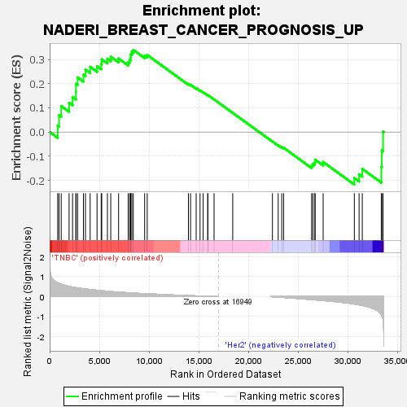
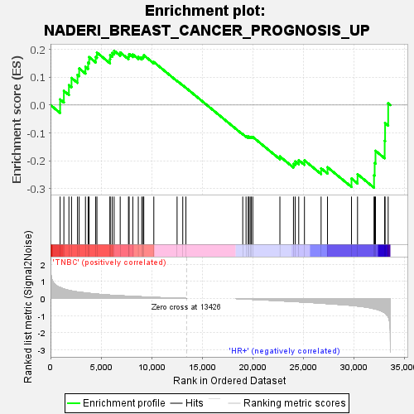
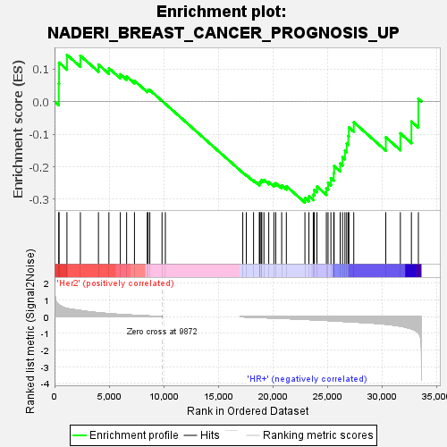
Good Prognosis Gene Set
TNBC enriched over Her2
HR+ enriched over TNBC
HR+ enriched over Her2
Fig.5 Enrichment Plots pt.1
Naderi, A., Teschendorff, A., Barbosa-Morais, N. et al. A gene-expression signature to predict survival in breast cancer across independent data sets. Oncogene 26, 1507–1516 (2007). https://doi.org/10.1038/sj.onc.1209920 http://www.gsea-msigdb.org/gsea/msigdb/geneset_page.jsp?geneSetName=NADERI_BREAST_CANCER_PROGNOSIS_UP

Slide 15
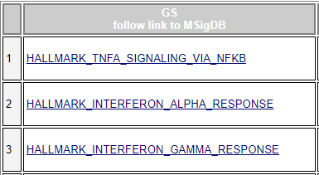
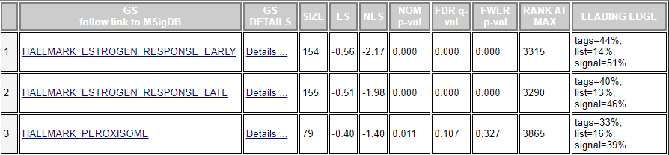
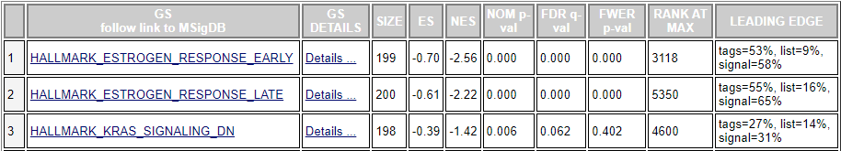
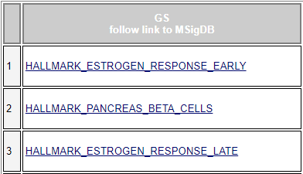
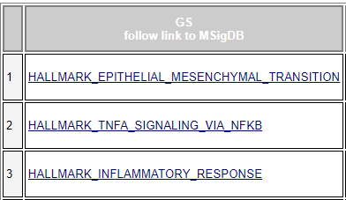
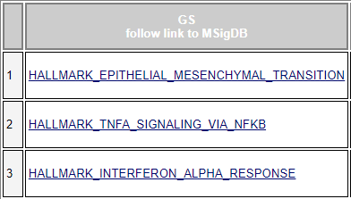
GSEA Hallmarks (50 gene sets) Top vs. Bottom
Her2+
Her2+
HR+
Vs.
HR+
TNBC
TNBC
https://www.gsea-msigdb.org/gsea/msigdb/genesets.jsp?collection=H

Slide 16
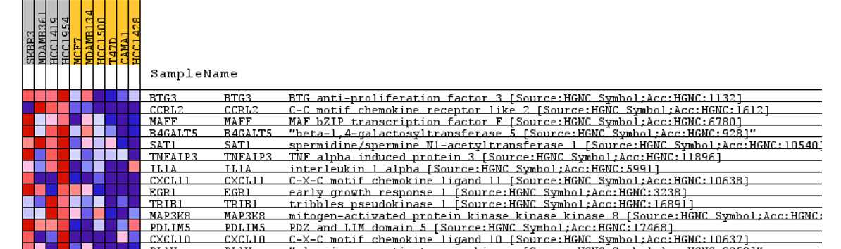
GSEA Hallmarks - Her2+ Vs. HR+ TNFa Signaling
Example
Her2+
HR+
Fig.6 Heat Map

Slide 17
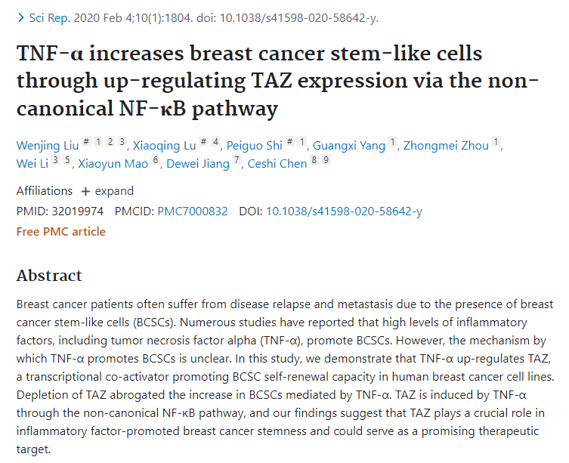
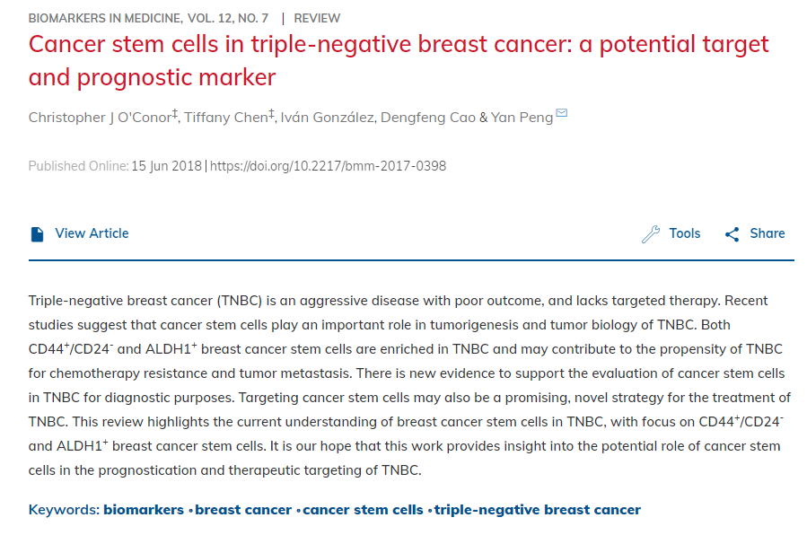
TNBC Enriched in TNFɑ Gene Set - Possibly also Cancer Stem Cell (CSC) genes?

Slide 18
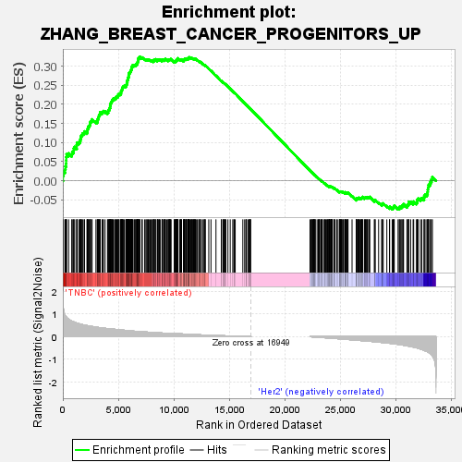
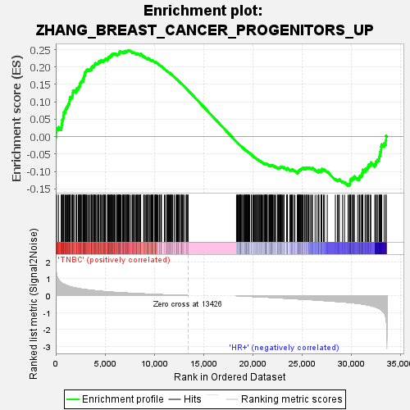
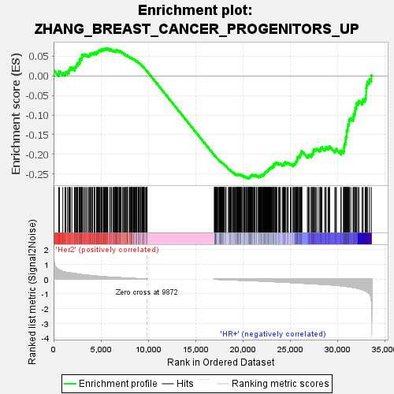
Cancer Stem Cell Gene Set
TNBC enriched over Her2
TNBC enriched over HR+
HR+ enriched over Her2
Fig.7 Enrichment Plots pt. 2
Zhang, Mei et al. “Identification of tumor-initiating cells in a p53-null mouse model of breast cancer.” Cancer research vol. 68,12 (2008): 4674-82. doi:10.1158/0008-5472.CAN-07-6353’
http://www.gsea-msigdb.org/gsea/msigdb/geneset_page.jsp?geneSetName=ZHANG_BREAST_CANCER_PROGENITORS_UP&keywords=breast%20AND%20cancer

Slide 19
Discussion
Normal vs tumor samples can be classified on the basis of a minimum of 5 genes out of 17814 genes for this particular dataset with a strict ANOVA F-test score threshold of >=220. 3 genes are known to be elevated in cancers and 2 are known to have lower expression in cancers. Threshold values can be altered to increase or decrease the number of genes/features used for the downstream classification task. Classification metrics further improve with 11 genes(features) that were also used for phenotyping
GSEA can be used to discover differences between tumor subtypes in terms of expression of molecular pathways, as well as expression of prognosis related genes. In a single prognosis-related breast cancer gene set, HR+ cell lines had the best good-prognosis-gene enrichment while Her2+ cell lines had the worst. TNBC cells were enriched for the EMT and TNFɑ sets, the latter potentially helping to drive enrichment in CSC-related genes.
Phenotyping shows the clear appearance of 2 clusters. This is verified through a variety of models, parameters and data scaling as part of the methodology. With feature selection an improvement in both silhouette coefficient and homogeneity score were achieved but the cluster number stays constant, i.e 2
Biomarker discovery is being performed with GSEA and through ANOVA filtering during phenotyping and classification.

Slide 20
Future Steps
Bigger dataset and better data pre-processing methods
Advanced machine learning tools
More computational resources - like GPUs and computing clusters
GridSearchCV only tests hyperparameters that are fed into ‘param_grid’. Including more parameters can be computationally expensive - Better feature engineering and feature selection may further improve results .
Better and more GSEA tumor cell lines (more than 4-6 in one label), more recent GSEA gene sets reflecting new research discoveries
Perform hierarchical clustering as feature selection step instead of the ANOVA f-test to see if it improves silhouette coefficient score
Perform information gain on the proposed clusters to assess the correlation between the features

Slide 21
References
[1] Paula Branco, Luis Torgo, Rita Ribeiro. Survey of Predictive Modelling under Imbalanced Distributions. arXiv 1505.01658 (2015)
[2] Sung, H., Ferlay, J., Siegel, R. L., Laversanne, M., Soerjomataram, I., Jemal, A., Bray, F. Global cancer statistics 2020: GLOBOCAN Estimates of Incidence and Mortality Worldwide for 36 Cancers in 185 Countries. CA: A Cancer Journal for Clinicians, 71(3), 209–249. https://doi.org/10.3322/caac.21660 , 2021
[3]Fionn Murtagh Multilayer perceptrons for classification and regression Neurocomputing, 2(5), https://doi.org/10.1016/0925-2312(91)90023-5 , 2004
[4]Batista, Gustavo E. A. P. A. and Prati, Ronaldo C. and Monard, Maria Carolina A Study of the Behavior of Several Methods for Balancing Machine Learning Training Data Association for Computing Machinery, 6(1), https://doi.org/10.1145/1007730.1007735 , 2004
[5]Chawla, Nitesh V. and Bowyer, Kevin W. and Hall, Lawrence O. and Kegelmeyer, W. Philip SMOTE: Synthetic Minority over-Sampling Technique AI Access Foundation, 16(1), https://doi/10.5555/1622407.1622416 , 2002
[6] Ma, Shuangge and Huang,Jian Penalized feature selection and classification in bioinformatics Briefings in Bioinformatics, Volume 9, Issue 5, https://doi.org/10.1093/bib/bbn027, 2008

